Slide 1


Integrity 101
INTEGRITY
.gov
Play your part.

Slide 2

Topics
Learn about Integrity
Filer My Tasks
Reviewer My Queue
Administration
Questions
Integrity@oge.gov
Help Desk: 202.208.0848
OGE Public Financial Disclosure Guide, https://www2.oge.gov/Web/278eGuide.nsf

Slide 3
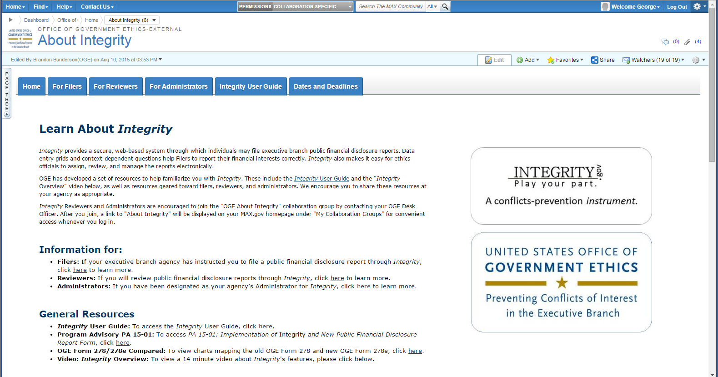
Learn about Integrity
https://community.max.gov/x/vQApLg
3

Slide 4
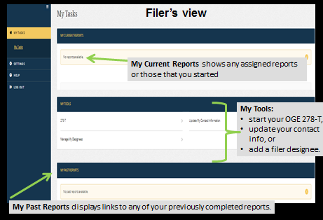
Filer My Tasks

Slide 5
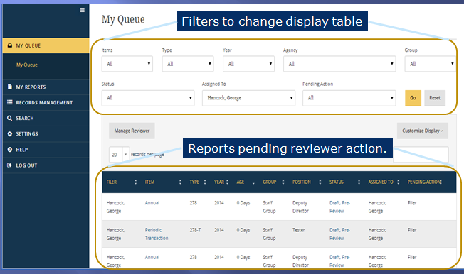
Reviewer My Queue

Slide 6
Administration
Manage agencies & groups
  Bulk assign reports (agency)
  Assign reports (group level)
Find User
Management Reports

Slide 7
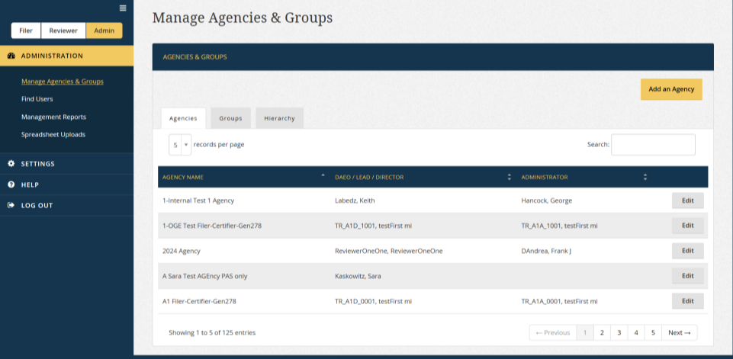
Administration

Slide 8
Questions
?
8

Slide 9

Integrity@oge.gov
Help Desk: 202.208.0848
OGE Public Financial Disclosure Guide, https://www2.oge.gov/Web/278eGuide.nsf
INTEGRITY
.gov
Play your part.
9

